Slide 1

Material Library
The RISA-3D material tables as the reference for Python Solver Rev.2
Eight material tabs, 41 materials, one masonry self-weight rule, in Imperial and Standard Metric. What every column means, how the numbers were derived, and how the solver should consume them.
Mark Airol Escranda | Numerical Methods, Lab 03 | September 2026
Notes:
Source: nine screenshots in the Materials folder. Companion workbook: RISA_Materials_Library.xlsx.

Slide 2

Where material properties enter the solver
A stiffness solver never uses a material name. It uses four numbers, and a fifth for loads. Everything on the eight RISA tabs exists to supply these.
E
G
ν
γ
α
Modulus of elasticity
Shear modulus
Poisson's ratio
Density
Thermal coefficient
Axial term EA/L and bending terms 12EI/L³, 6EI/L², 4EI/L in the member stiffness matrix. Also plate membrane stiffness.
Torsional stiffness GJ/L, and the shear-deformation correction on deep members. Isotropic rule: G = E / 2(1+ν).
Links G to E and sets the in-plane coupling of plate and shell elements.
Self-weight load: w = γ · A per unit length. Converted to nodal forces in the load vector.
Thermal strain α·ΔT, turned into equivalent member end forces for temperature load cases.
Strengths (Fy, Fu, f'c, f'm, Ftu) do not change the stiffness solution. They belong to the design-check layer that sits on top of the analysis.
Python Solver Rev.2 | Material Library | 2

Slide 3

The library at a glance
8
41
5
material tabs in RISA-3D
materials transcribed
stiffness properties shared by every tab
Tab | Rows | What it holds | Extra columns beyond the shared five
Hot Rolled | 5 | A36, A572, A992, A500 steels | Yield, Fu, Ry, Rt
Cold Formed | 2 | A570_33, A607_C1_55 | Yield, Fu
Wood | 12 | Solid sawn, glulam, LVL | Type, Database, Species, Grade, Cm, Ci, Emod
Concrete | 6 | 3 to 4 ksi, normal and lightweight | f'c, Lambda, Flex Steel, Shear Steel
Masonry | 2 | Concrete and clay masonry | f'm, Flex Steel, Shear Steel, Self Weight rule
Aluminum | 6 | 3003, 5052, 6061, 6063 alloys | Table B.4, kt, Ftu, Fty, Fcy, Fsu, Ct
Stainless | 1 | SS1 | n (Ramberg-Osgood), Yield, Fu
General | 7 | Generic concrete, aluminum, steel, RIGID | Plate Methodology
Python Solver Rev.2 | Material Library | 3

Slide 4

The five shared columns, and their units
Column | RISA unit | Meaning | Solver note
E [ksi] | kip/in² | Modulus of elasticity | 1 ksi = 6.894757 MPa. Steel 29,000 ksi = 199,948 MPa.
G [ksi] | kip/in² | Shear modulus | Derive from E and ν when blank; tabulated G agrees within 0.1% on 22 of 28 rows.
Nu | dimensionless | Poisson's ratio | Steel 0.30, concrete 0.15, masonry 0.25, aluminum 0.33, wood 0.30.
Therm. Coeff. [1e-5/°F] | 10⁻⁵ per °F | Coefficient of thermal expansion | Multiply by 1e-5 first: steel 0.65 → 6.5e-6 /°F = 11.7e-6 /°C.
Density [k/ft³] | kip/ft³ | Unit weight for self-weight | 1 k/ft³ = 157.09 kN/m³. Steel 0.49 k/ft³ = 490 pcf = 77.0 kN/m³.
Unit strategy for the solver
Consistency check built into the workbook
Every sheet in the workbook carries two tables: Imperial as RISA shows it (ksi, k/ft³, 1e-5/°F) and, below it, Standard Metric (MPa, kN/m³, kg/m³, 1e-6/°C) computed by formula. All factors derive from 1 in = 25.4 mm, 1 lbf = 4.4482216152605 N and g = 9.80665 m/s² on the Conversion Factors sheet.
A mixed-unit row is the classic silent error; the Stainless tab shows what that looks like.
Every tab with a G column carries a green formula column: G_calc = E / 2(1+ν), and the percentage difference from the tabulated G.
22 of the 28 rows with a G value agree within 0.1%. The six aluminum rows carry a fixed 3,787.5 ksi, which is 3E/8 with E = 10,100 (ν = 1/3 exactly), so they sit 0.25% off, and 1.2% off for 5052 with its E of 10,200.
Python Solver Rev.2 | Material Library | 4

Slide 5
The library in Standard Metric (1 of 2)
Steels, concrete and masonry. Every value is E, G or strength × 6.894757 (ksi to MPa), density × 157.0875 (k/ft³ to kN/m³), thermal × 18 (1e-5/°F to 1e-6/°C). The Metric tables in the workbook compute these by formula.
Tab | Label | E [MPa] | G [MPa] | ν | α [1e-6/°C] | γ [kN/m³] | kg/m³ | Fy / f'c / f'm [MPa] | Fu [MPa]
Hot Rolled | A36 Gr.36 | 199,948 | 76,904 | 0.30 | 11.7 | 76.97 | 7,849 | 248.2 | 399.9
Hot Rolled | A572 Gr.50 / A992 | 199,948 | 76,904 | 0.30 | 11.7 | 76.97 | 7,849 | 344.7 | 399.9
Hot Rolled | A500 Gr.42 / Gr.46 | 199,948 | 76,904 | 0.30 | 11.7 | 76.97 | 7,849 | 289.6 / 317.2 | 399.9
Cold Formed | A570_33 | 203,395 | 78,228 | 0.30 | 11.7 | 76.97 | 7,849 | 227.5 | 358.5
Cold Formed | A607_C1_55 | 203,395 | 78,228 | 0.30 | 11.7 | 76.97 | 7,849 | 379.2 | 482.6
Concrete | Conc3000NW | 21,760 | 9,460 | 0.15 | 10.8 | 22.78 | 2,323 | 20.7
Concrete | Conc3500NW | 23,504 | 10,218 | 0.15 | 10.8 | 22.78 | 2,323 | 24.1
Concrete | Conc4000NW | 25,124 | 10,921 | 0.15 | 10.8 | 22.78 | 2,323 | 27.6
Concrete | Conc3000LW | 14,376 | 6,254 | 0.15 | 10.8 | 17.28 | 1,762 | 20.7
Concrete | Conc3500LW | 15,527 | 6,750 | 0.15 | 10.8 | 17.28 | 1,762 | 24.1
Concrete | Conc4000LW | 16,603 | 7,219 | 0.15 | 10.8 | 17.28 | 1,762 | 27.6
Masonry | Concrete Matl | 9,308 | 3,723 | 0.25 | 10.8 | Custom | Custom | 10.3
Masonry | Clay Matl | 7,240 | 2,896 | 0.25 | 10.8 | Custom | Custom | 10.3
Rebar for concrete and masonry (Flex Steel and Shear Steel, 60 ksi) is 413.7 MPa in every row: NSCP Grade 420.
Python Solver Rev.2 | Material Library | 5

Slide 6
The library in Standard Metric (2 of 2)
Aluminum, general materials, wood and stainless. Aluminum strengths are Ftu / Fty; the General tab has no strength columns.
Tab | Label | E [MPa] | G [MPa] | ν | α [1e-6/°C] | γ [kN/m³] | kg/m³ | Ftu / Fty [MPa]
Aluminum | 3003-H14 | 69,637 | 26,114 | 0.33 | 23.4 | 27.18 | 2,771 | 131.0 / 110.3
Aluminum | 6061-T6 | 69,637 | 26,114 | 0.33 | 23.4 | 27.18 | 2,771 | 262.0 / 241.3
Aluminum | 6063-T5 | 69,637 | 26,114 | 0.33 | 23.4 | 27.18 | 2,771 | 151.7 / 110.3
Aluminum | 6063-T6 | 69,637 | 26,114 | 0.33 | 23.4 | 27.18 | 2,771 | 206.8 / 172.4
Aluminum | 5052-H34 | 70,327 | 26,114 | 0.33 | 23.4 | 27.18 | 2,771 | 234.4 / 179.3
Aluminum | 6061-T6 (welded) | 69,637 | 26,114 | 0.33 | 23.4 | 27.18 | 2,771 | 165.5 / 103.4
General | gen_Conc3NW / 4NW | 21,753 / 25,124 | 9,460 / 10,921 | 0.15 | 10.8 | 22.78 | 2,323
General | gen_Conc3LW / 4LW | 14,376 / 16,603 | 6,247 / 7,219 | 0.15 | 10.8 | 17.28 | 1,762
General | gen_Alum | 73,084 | 28,110 | 0.30 | 23.2 | 27.18 | 2,771
General | gen_Steel | 199,948 | 76,904 | 0.30 | 11.7 | 76.97 | 7,849
General | RIGID | 6.89e+6 |  | 0.30 | 0 | 0 | 0
Wood | all 12 entries | NDS lookup |  | 0.30 | 5.4 | 5.50 | 561
Stainless | SS1 | as displayed: SI under ksi headers, see the Stainless slide |  | 0.30
Python Solver Rev.2 | Material Library | 6

Slide 7

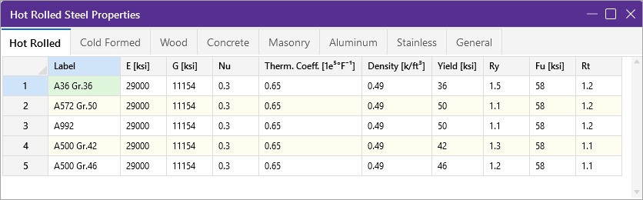
Hot Rolled steel
Five ASTM grades. Stiffness is identical across all of them: E = 29,000 ksi, G = 11,154 ksi, ν = 0.30, γ = 0.49 k/ft³.
Only the strength columns differ. A36 yields at 36 ksi; A572 Gr.50 and A992 at 50 ksi; A500 tube steels at 42 and 46 ksi. Fu is 58 ksi throughout.
Ry and Rt are the AISC 341 expected-strength ratios. Ry × Fy is the expected yield (A36: 1.5 × 36 = 54 ksi), used when a seismic design must guarantee that a brace or link yields before its connection.
For the solver: one stiffness set, five design labels. The material dictionary can share E, G, ν and vary only Fy, Fu, Ry, Rt.
Materials-SS-Hot-Rolled-TAB.png
Density check
0.49 k/ft³ × 1000 = 490 pcf, the standard unit weight of structural steel. A W12×26 (A = 7.65 in²) weighs 490 × 7.65/144 = 26.0 lb/ft, matching its designation.
Python Solver Rev.2 | Material Library | 7

Slide 8
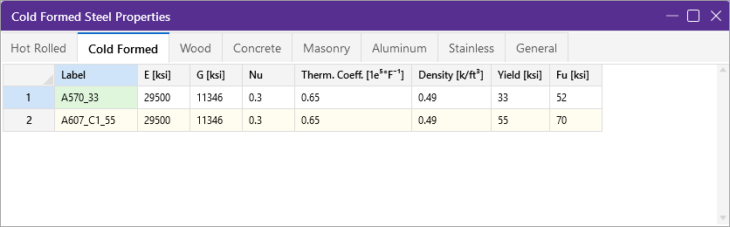
Cold Formed steel
Two sheet-steel grades used for light-gauge framing: A570 Gr.33 (Fy 33, Fu 52 ksi) and A607 Class 1 Gr.55 (Fy 55, Fu 70 ksi).
Note the different modulus: E = 29,500 ksi, not 29,000. AISI S100 specifies 29,500 ksi for cold-formed members, and G = 11,346 ksi follows from E / 2(1.3).
No Ry or Rt columns. Cold-formed design under AISI does not use the AISC expected-strength factors.
For the solver: keep this tab separate from Hot Rolled even though the numbers look alike. A 1.7% difference in E is real and shows up in deflections.
Materials-SS-Cold-Formed-TAB.png
Why 29,500 matters
Deflection is proportional to 1/E, so swapping in 29,000 ksi overstates cold-formed deflection by 1.7%. Small, but it is the kind of drift that makes a solver disagree with RISA on a benchmark.
Python Solver Rev.2 | Material Library | 8

Slide 9

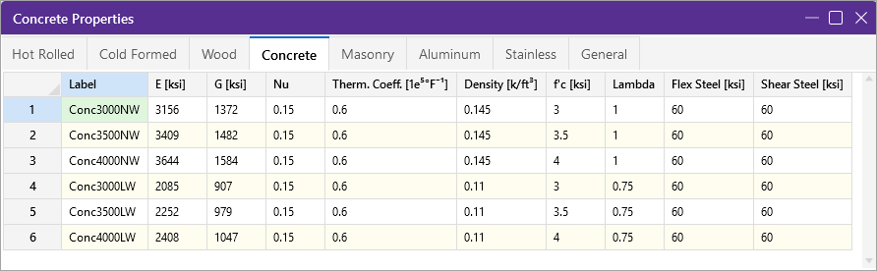
Concrete
Six mixes: 3,000, 3,500 and 4,000 psi, each in normal weight (145 pcf, λ = 1.0) and lightweight (110 pcf, λ = 0.75).
E is not typed in; it is derived from f'c and unit weight with ACI 318 Eq. 19.2.2.1(a): Ec = wc¹·⁵ · 33 · √f'c (psi).
Check: 145¹·⁵ × 33 × √3000 = 3,156,000 psi = 3,156 ksi, exactly the Conc3000NW value. For 110 pcf: 2,085 ksi, matching Conc3000LW.
ν = 0.15 for all mixes, so G = E / 2.3. Flex Steel and Shear Steel (60 ksi) are the Grade 60 rebar yield used by the design layer only.
Materials-SS-Concrete-TAB.png
Rule for the solver
Store f'c and γ as the inputs and compute E on load: E_ksi = (γ_pcf)^1.5 × 33 × √(f'c_psi) / 1000. That reproduces every RISA value to the nearest ksi and keeps custom mixes consistent.
Python Solver Rev.2 | Material Library | 9

Slide 10
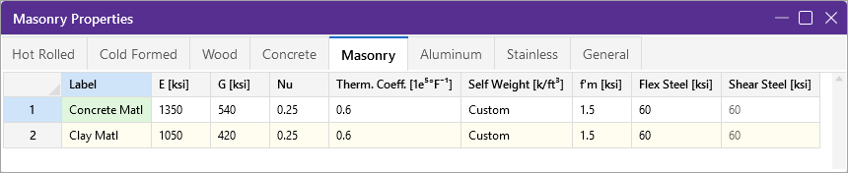
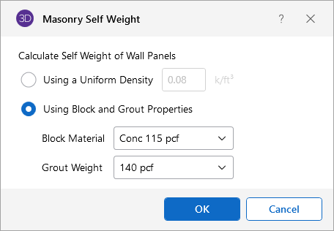
Masonry, and how its self-weight is computed
Two assemblies: concrete masonry (E 1,350 ksi) and clay masonry (E 1,050 ksi), both with f'm = 1.5 ksi and ν = 0.25.
E follows TMS 402: Em = 900 f'm for concrete masonry (900 × 1.5 = 1,350) and 700 f'm for clay (700 × 1.5 = 1,050). G = 0.4 Em = 540 and 420 ksi, which also equals E / 2(1.25).
For the solver: masonry needs a wall-panel weight routine, not a scalar density. Simplest faithful implementation: weight per area = f(block thickness, block density, grout density, grout spacing) from the NCMA tables, with 80 pcf as the fallback.
Materials-SS-Masonry-TAB.png
Self Weight = Custom
The tab does not carry a density. Instead the dialog selects "Using Block and Grout Properties": block material Conc 115 pcf, grout 140 pcf.
Wall weight then depends on block thickness and grout spacing. The greyed-out alternative is a uniform 0.08 k/ft³ (80 pcf).
Masonry-Self-Weight-WND.png
Python Solver Rev.2 | Material Library | 10

Slide 11

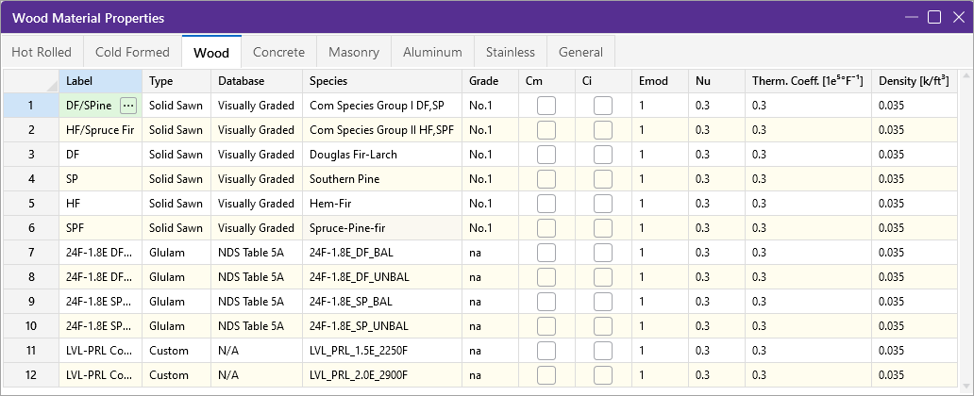
Wood
Twelve entries in three families: six visually graded solid-sawn species (No.1), four 24F-1.8E glulam layups from NDS Table 5A (balanced and unbalanced, DF and SP), and two custom LVL products (1.5E-2250F, 2.0E-2900F).
This tab stores keys, not stiffness. E, Fb, Fv and Fc are looked up in the NDS Supplement by Type, Database, Species and Grade; Emod (1.0) scales the tabulated E, and Cm / Ci apply wet-service and incising factors when checked (none are).
Shared values: ν = 0.30, α = 0.3 × 1e-5 /°F, γ = 0.035 k/ft³ (35 pcf).
For the solver: wood needs a lookup layer. Until the NDS table is loaded, a placeholder E (for example 1,700 ksi for No.1 DF-L) keeps the model solvable.
Materials-SS-Wood-TAB.png (labels in rows 7 to 12 are truncated on screen; reconstructed from Species)
The glulam label decoded
24F-1.8E: allowable bending stress 2,400 psi and E = 1.8 × 10⁶ psi = 1,800 ksi. BAL and UNBAL mark balanced or unbalanced layups; DF and SP are Douglas Fir and Southern Pine laminations.
Python Solver Rev.2 | Material Library | 11

Slide 12

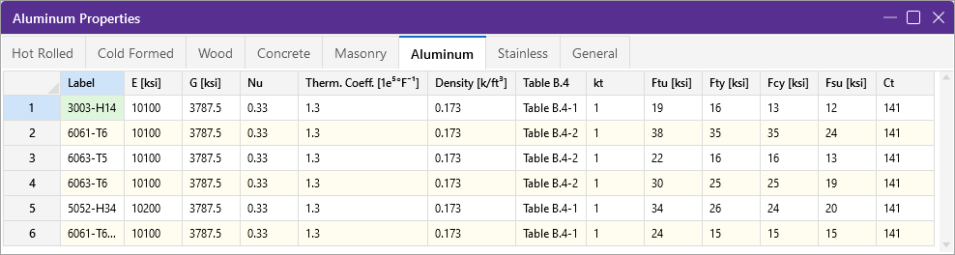
Aluminum
Six alloy-tempers: 3003-H14, 5052-H34, 6061-T6 (plain and welded), 6063-T5 and 6063-T6.
Stiffness is nearly constant: E = 10,100 ksi (10,200 for 5052), G = 3,787.5 ksi for every row (3E/8, the ADM value for ν = 1/3), ν = 0.33, γ = 0.173 k/ft³ (173 pcf), α = 1.3 × 1e-5 /°F, twice that of steel.
Strength columns follow the Aluminum Design Manual: Ftu, Fty (tension), Fcy (compression), Fsu (shear), with kt = 1.0 and the buckling constants taken from Table B.4-1 or B.4-2 depending on temper. Ct = 141 is the compression constant.
Welding halves the strength but not the stiffness: 6061-T6 drops from Fty 35 to 15 ksi in the welded row while E stays at 10,100 ksi.
Materials-SS-Aluminum-TAB.png (row 6 truncated on screen; strengths match welded 6061-T6)
Thermal note for the solver
Aluminum expands at 13.0e-6 /°F versus 6.5e-6 for steel. A 40 ft aluminum member under a 60 °F rise grows 0.37 in; the same steel member grows 0.19 in. Thermal load cases must read α per material, not a global constant.
Python Solver Rev.2 | Material Library | 12

Slide 13

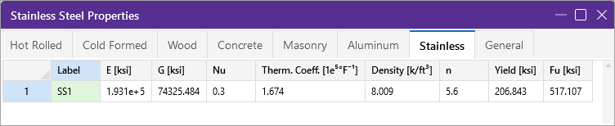
Stainless: one row, and a unit trap
SS1 is the only stainless entry. Its values sit under ksi headers but are SI magnitudes: 30 ksi yield and 75 ksi ultimate are the textbook Type 304 values, and 193 GPa is its modulus.
n = 5.6 is the Ramberg-Osgood exponent, the one property unique to this tab. Stainless has no sharp yield, so RISA models the stress-strain curve as ε = σ/E + 0.002 (σ/Fy)ⁿ.
Treat this row as a caution, not a value. Either RISA's unit setting changed while the row was entered, or the row was pasted from an SI source. Confirm before the solver uses it.
The workbook records the row as displayed and flags it on the Stainless and All Materials sheets.
Materials-SS-Stainless-TAB.png
Column | Displayed | If read as ksi | If read as MPa
E | 1.931e+5 | 193,100 ksi (6.7× steel) | 193,100 MPa = 28,000 ksi
Yield | 206.843 | 206.8 ksi | 206.843 MPa = 30.0 ksi
Fu | 517.107 | 517.1 ksi | 517.107 MPa = 75.0 ksi
Density | 8.009 | 8,009 pcf | 8.0 g/cm³ (specific gravity of stainless)
Python Solver Rev.2 | Material Library | 13

Slide 14
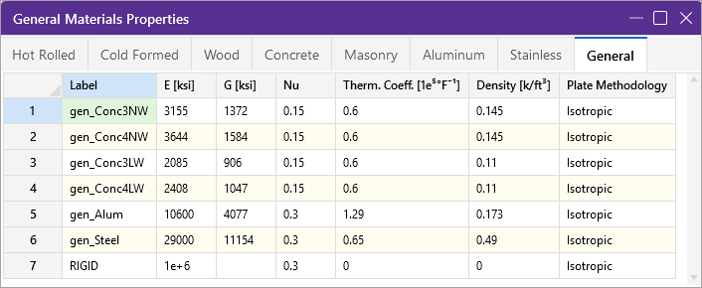
General materials and the RIGID link
Seven generic entries for plates, solids and quick models: four concretes (3 and 4 ksi, normal and lightweight), one aluminum, one steel, and RIGID.
gen_Conc3NW (E 3,155) and gen_Conc4NW (E 3,644) mirror the Concrete tab values within 1 ksi; gen_Alum uses E 10,600 ksi and α 1.29, slightly different from the Aluminum tab.
Plate Methodology = Isotropic for every entry: the same E in every in-plane direction, which is what the solver's plate stiffness should assume.
RIGID has E = 1e+6 ksi, no G, and zero density and thermal coefficient. It is a modeling device for stiff links and rigid offsets, not a real material.
Materials-SS-General-TAB.png
Handling RIGID in the solver
Do not simply use E = 1e6 in the stiffness matrix; a 34:1 stiffness ratio to steel is fine, but combine it with tiny members and the matrix becomes ill-conditioned. Better: implement rigid links as constraint equations, or cap E at 1,000× the stiffest real material.
Python Solver Rev.2 | Material Library | 14

Slide 15

How Solver Rev.2 should consume the library
from dataclasses import dataclass
import pandas as pd
@dataclass
class Material:
label: str; category: str
E: float; nu: float; density: float
alpha: float; G: float | None = None
Fy: float | None = None; Fu: float | None = None
def __post_init__(self):
if self.G is None: # isotropic rule
self.G = self.E / (2 * (1 + self.nu))
self.alpha *= 1e-5 # RISA stores 1e-5/degF
df = pd.read_excel('RISA_Materials_Library.xlsx',
sheet_name='All Materials', header=3)
LIB = {r['Label']: Material(r['Label'], r['Category'],
r['E [ksi]'], r['Nu'], r['Density [k/ft³]'],
r['Therm. Coeff. [1e-5/°F]'], r['G [ksi]'])
for _, r in df.iterrows() if isinstance(r['Label'], str)}
1
Read, do not retype
The All Materials sheet is the single source. Category + Label is the key; the eight tab sheets stay as the audit trail against the screenshots.
2
Derive G, do not store it
22 of 28 RISA values satisfy G = E / 2(1+ν) within 0.1%; only aluminum's fixed 3,787.5 differs, by 0.25% to 1.2%. Deriving removes one column that can drift.
3
Convert units once
Keep kip-inch internally or switch to kN-m at load time using the SI columns. Never mix inside a stiffness matrix.
4
Separate analysis from design
E, G, ν, γ, α feed the solver. Fy, Fu, f'c, f'm, Ry, Rt feed a later code-check module.
5
Special cases
Concrete E from f'c; masonry weight from block and grout; wood E from an NDS lookup; RIGID as a constraint.
Python Solver Rev.2 | Material Library | 15

Slide 16

Transcription checks and caveats
Verified against the source
Recorded as displayed, with a flag
Concrete E values reproduce ACI 318 Eq. 19.2.2.1(a) to the nearest ksi for all six mixes.
Masonry E equals 900 f'm (concrete) and 700 f'm (clay) exactly.
Cold-formed G = 29,500 / 2.6 = 11,346 ksi. Hot-rolled G = 29,000 / 2.6 = 11,154 ksi.
22 of 28 tabulated G values agree with E / 2(1+ν) within 0.1%; aluminum's fixed 3,787.5 ksi (= 3E/8) is the exception.
Stainless SS1: SI magnitudes under ksi headers. Do not use until the unit basis is confirmed in RISA.
General RIGID: G is blank in RISA and left blank in the workbook.
gen_Alum (E 10,600, α 1.29) differs slightly from the Aluminum tab (10,100, 1.3). Both kept as shown.
Labels reconstructed where the screen cut them off
What the workbook gives you
Wood rows 7 to 12 read "24F-1.8E DF..." and "LVL-PRL Co..." on screen. Full labels were rebuilt from the Species column (24F-1.8E DF_BAL, LVL-PRL 1.5E_2250F, and so on).
Aluminum row 6 reads "6061-T6..."; its strengths (Ftu 24, Fty 15) are the welded 6061-T6 values, so it is labelled 6061-T6 (welded).
README with these notes, and a Conversion Factors sheet derived from three exact definitions.
One sheet per RISA tab: the Imperial table as transcribed (blue), a green G check, and a Standard Metric table below it computed by formula.
Masonry Self Weight dialog captured on the Masonry sheet.
All Materials: 41 rows, Imperial columns C to I and Metric columns J to P, filterable.
Glossary: every column, its meaning and its use in the solver.
Python Solver Rev.2 | Material Library | 16

Slide 17
Next steps for Rev.2
1
2
3
4
Load
Benchmark
Extend
Resolve
Read All Materials into a Material dataclass; derive G; convert α.
Run the 6 m cube with A992 and Conc4000NW; compare deflections with RISA.
Add the concrete E rule, masonry wall weight, and an NDS wood lookup.
Confirm the Stainless unit basis in RISA and update the row.
Files in the Materials folder: RISA_Materials_Library.xlsx and this deck. Source screenshots remain the authority; the workbook is the working copy.

